Slide 1
CHEMISTRY
CHEMISTRY IS A BRANCH OF SCIENCE THAT DEALS WITH THE COMPOSITION, PROPERTIES AND USES OF MATTER.

Slide 2
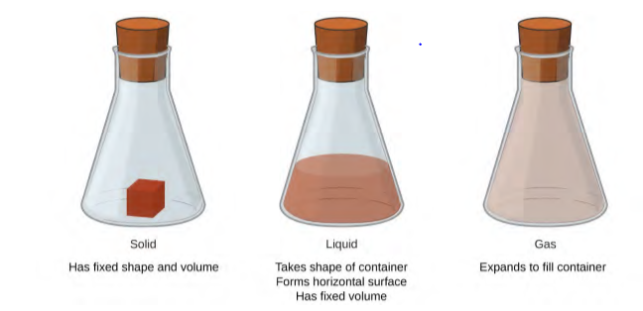
WHAT IS MATTER
MATTER IS ANYTHING THAT HAS MASS AND CAN OCCUPY SPACE.
WE HAVE BASICALLY 3 STATES OF MATTER

Slide 3
The mass of an object is a measure of the amount of matter in it. WHILE Weight refers to the force that gravity exerts on an object. This force is directly proportional to the mass of the object
The weight of an object changes as the force of gravity changes, but its mass does not. An astronaut’s mass does not change just because she goes to the moon. But her weight on the moon is only one-sixth her earth-bound weight because the moon’s gravity is only one-sixth that of the earth’s. She may feel “weightless” during her trip when she experiences negligible external forces (gravitational or any other), although she is, of course, never “massless.”

Slide 4
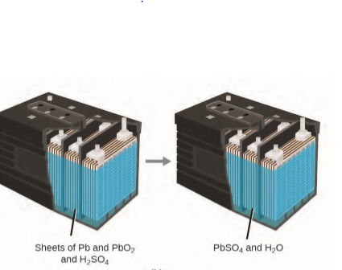
The law of conservation of matter summarizes many scientific observations about matter: It states that MATTER CAN NEITHER BE CREARED NOR DESTROYED BUT TRANSFORMED FROM ONE FORM TO ANOTHER.
This can also be seen in a lead-acid car battery: The original substances ( lead, lead oxide, and sulfuric acid ), which are capable of producing electricity, are changed into other substances (lead sulfate and water) that do not produce electricity, with no change in the actual amount of matter.

Slide 5
ATOMS AND MOLECULES
AN ATOM IS THE SMALLEST PARTICLE OF A SUBSTANCE THAT HAS THE PROPERTY OF THAT SUBSTANCE AND CAN TAKE PART IN A CHEMICAL REACTION.
Consider the element gold, for example. Imagine cutting a gold nugget in half, then cutting one of the halves in half, and repeating this process until a piece of gold remained that was so small that it could not be cut in half (regardless of how tiny your knife may be ). This minimally sized piece of gold is an atom (from the Greek atomos, meaning “indivisible”)

Slide 6
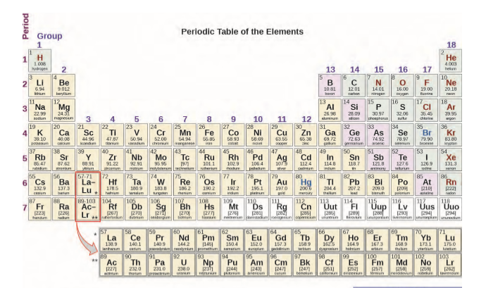
AN ELEMENT IS A SUBTANCE WHICH CONSIST OF INDIVIBLE PARTICLES CALLED ATOMS

Slide 7
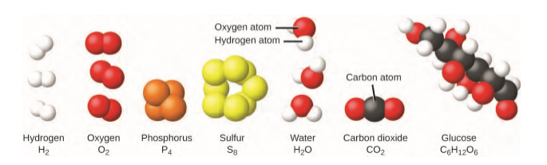
The element sulfur exists in various forms, one of which consists of units composed of eight sulfur atoms. These units are called molecules. A molecule consists of two or more atoms joined by strong forces called chemical bond.
The elements hydrogen, oxygen, phosphorus, and sulfur atoms of the same element while water, carbon dioxide, and glucose consist of combinations of atoms of different elements.

Slide 8
An Element could have one, two or more atoms.
Elements with a single atom are said to be monoatomic. Examples include neon, argon
Elements with two atoms are said to be diatomic, examples include hydrogen, chlorine
Elements with three or more atoms are said to be polyatomic, examples include ozone, Sulphur, phosphorus

Slide 9
THE END
e-Lesson

